Slide 1
Customer Analytics Report - How can X leverage “Money cashback” to increase customer retention for long-term growth?
Prepared by Hao Tran (Ms.)
February, 2024

Slide 2

Context setting
X is a digital wallet offering online money transfer and payment services. In early 2022, they launched a Loyalty Program called "Money Cashback," designed to enhance customer retention by rewarding users with cashback based on their transaction activity.
By analyzing over 49,000 transactions from 2021 to Q1 of 2022, X aims to identify opportunities to optimize the loyalty program and develop strategies to increase user retention.
Executive summary:
My recommendations are as follows:
Targeting marketing campaigns specifically during the December-January and post-Tet seasons while prioritizing the promotion of the 'marketplace' service. This approach will enhance cost-efficiency in marketing investments by targeting service areas with the highest potential for driving customer retention.
Developing tailored marketing strategies for each user segment. By customizing approaches for different user types, resources can be allocated effectively, ensuring that their specific needs are met, ultimately driving retention and growth.
Reducing the cashback percentage for the CVS service within the loyalty program, with more significant cuts applied to classes 2 and 3. This adjustment will lower the most reward costs while preserving customer retention and supporting continued growth in spending.

Slide 3
To increase customer’s retention, we can:
Targeting marketing campaigns specifically during the December-January and post-Tet seasons while prioritizing the promotion of the 'marketplace' service.
Develop marketing strategies tailored to each user segment.

Slide 4
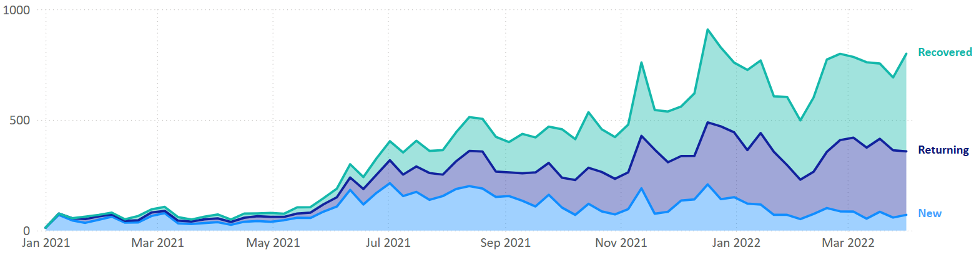
The year-end transition (December and January) and the post-Tet period (from March) are key seasons for driving high retention, particularly for users who continue using the services or have returned after churning
1
Number of customers
Implications
The number of returning and recovered customers typically peaks at the end of the year, declines during the Tet holiday, and then gains momentum afterward.

Slide 5
The high frequency of transactions in the Marketplace drives the trend for the two major peaks in customer retention.
1
Number of transactions by service group, count
Total
Marketplace
Implications
The number of transactions for the marketplace shows a significant increase in traffic from December to January and after March, aligning closely with the overall trend

Slide 6
Each segment of users need different approach at different time in a year. Tailor the strategy for campaign to fit with each customer segment (*)
2
Strategies for each customer segment
Champions | This segment of customer is not only loyal to X, they will also promote X. With this segment, we should reward them, introduce them with the newest features/products
Loyal | Leverage to upsell higher value products. Besides, this type of users will have plentiful amount of experience with X. We should ask them for their reviews, which features of X that they satisfied the most/least
Potential Loyalist | Offer them with membership / loyalty program and recommend them other products to upgrade them to “Loyal” segment
New Customers | Provide support after they’re on board, give them early success and start building relationship.
Promising | Create more touch points such as ads/workshops to create brand awareness and willingness to register to app
(*)Check appendix

Slide 7
Tailor the strategy for campaign to fit with each customer segment (*)
2
Strategies for each customer segment
Need Attention | This customer segment shows early signs of potential churn and requires additional attention. We should offer time-limited recommendations or rewards based on their past purchases to re-engage them and encourage continued usage. | The period from December to January, as well as after March, are the most ideal times to engage with these types of users.
About To Sleep | Share valuable resources with them and recommend popular products or discounted renewals to re-establish the connection.
At Risk | Send personalized emails to reconnect, offer renewals, provide helpful resources.
Cannot Lose Them | Win them back via renewals or newer products. This type of user we should not lose, especially to competition.
Hibernating customers | Offer other relevant products and special discounts
Lost customers | Revive interest through campaigns that can reach out them, ignore otherwise.
(*)Check appendix

Slide 8
To improve the Loyalty program scheme, we can:
Reduce the cashback percentage for the CVS service in the loyalty program, with a greater reduction applied to classes 2 and 3

Slide 9
Loyalty program schemes
Loyalty Points scheme
Loyalty benefit scheme
Service Group | Point Mechanism | Maximum Point Per Trans
supermarket | 1 points/1000VND GMV | 500 points
data | 10 points/1000VND GMV | 1000 points
cvs (convenient stores) | 1 points/1000VND GMV | 300 points
marketplace | 1 points/1000VND GMV | 500 points
Coffee chains and Milk tea | 1 points/1000VND GMV | 500 points
Offline Beverage | 1 points/1000VND GMV | 300 points
Class ID | Service Group | %cashback
3 | supermarket | 2
4 | supermarket | 5
2 | data | 5
3 | data | 7
4 | data | 12
2 | cvs (convenient stores) | 5
3 | cvs (convenient stores) | 7
4 | cvs (convenient stores) | 12
3 | marketplace | 2
4 | marketplace | 5
2 | Offline Beverage | 5
3 | Offline Beverage | 7
4 | Offline Beverage | 12

Slide 10
The priority for cost-cutting, in terms of intensity, is Marketplace, followed by CVS and Data.
3
Cashback Cost, by Service group, % on total
Implications:
The services with a higher share of cost will have a greater impact on cost reduction.
The Marketplace accounts for more than half of the total cost, making it the most promising area for cost reduction, followed by CVS and Data services
59
22
15
Marketplace | CVS | Data
4
< 1
Supermarket | Offline Beverage

Slide 11
However, reducing costs for Marketplace may not be ideal when it comes to sustaining the growth of customer spending
3
Correlation between Total and service retention, million
Correlation strength: 0.90
Correlation strength: 0.55
Correlation strength: 0.64
Implications
Changing the reward structure for Marketplace will eventually impact user spending. The scatter chart below shows a strong correlation of 0.9 between Marketplace spending and total spending. In the worst-case scenario, a decrease in Marketplace spending is likely to lead to a decrease in total spending as well. Before conducting further investigation, we should avoid taking the risk of altering one of the most critical services—Marketplace.
Please note that Correlation strength is measured by Pearson’s correlation coefficient, with value from
-1 to 1. The higher the value is, the stronger two variables are negatively/positively correlated

Slide 12
… and also, in terms of customer retention.
3
Correlation between Total and service retention, no. of transactions
Correlation strength: 0.89
Correlation strength: 0.87
Correlation strength: 0.85
Implications:
The correlation between the number of Marketplace and Total transactions is also strong, further supporting the decision to maintain the current reward structure for Marketplace.
Please note that Correlation strength is measured by Pearson’s correlation coefficient, with value from
-1 to 1. The higher the value is, the stronger two variables are negatively/positively correlated

Slide 13
Alternatively, the optimal solution to reduce cashback costs significantly is to decrease the cost for the CVS service, while carefully considering the impact on retention
3
CVS spending share, % on total
Correlation’s strength: 0.87
Implications:
CVS is the second-highest source of cashback costs, presenting a potential opportunity for cost reduction. Following the program’s launch, the significant decline in CVS spending suggests that customer spending is not offsetting the cashback costs. From a retention perspective, changes in CVS transactions are likely to align with changes in total transactions

Slide 14
The percentage cost for Classes 2 and 3 should be particularly considered for a reduction in the reward rate.
3
CVS Cashback cost by class, % on total
Implications:
Classes 2 and 3 account for nearly all of the cashback cost for CVS. Reducing the reward rate, especially for these two classes, will have a significant impact on lowering CVS costs
46
33
Rank 2 | Rank 3
21
Rank 4

Slide 15
Moving forwards – what to do next?
The analysis above has opened the door for the areas that worth further actions:
Collect more data over a longer period: By doing so, we can better track transaction trends, uncover valuable insights in a more stable context, and prepare high quality data for segmentation. This will enable more effective and tailored marketing strategies for each season and customer segment throughout the years.
Collaborate with other teams to refine the Loyalty program strategy: Given the limitations of the current dataset, the most effective changes should involve collaboration across teams, such as Product Management and Marketing. A reasonable starting point could be reducing the cashback percentage for the CVS service.
Conduct additional analyses:
Analyze how changes to the reward scheme will impact the total transaction volume and value, and the actual effect of Loyalty Program on the customer behavior
Perform A/B testing to evaluate the performance of the updated Loyalty program.

Slide 16
Appendix

Slide 17
Overview about the dataset used in this study
The dataset is the record of transactions of users made from 1 Jan 2021 to 31 Mar 2022 including information about the Merchant, Service group, amount of spending. Other tables are about the data for the Money cashback program
Transactions details
DATE | Date when the transaction was made
Order_id | ID of order
NEWVERTICAL_Merchant | Merchant
MerchantID | ID of Merchant
Users | ID of Users
GMV | Amount of spending of each order
Service Group | Type of service of transaction
7 columns, 49175 rows
Dim Loyalty Points
Service Group | Service type of transaction
Point Mechanism | Loyalty Points earned per 1000 GMV for each type of service
Maximum Point Per Trans | Maximum Loyalty Points can be earned per 1000 GMV for each type of service
Dim Loyalty Benefits
Class ID | ID of Class
Group | Type of service
%cashback | Percentage of money is returned based on

Slide 18
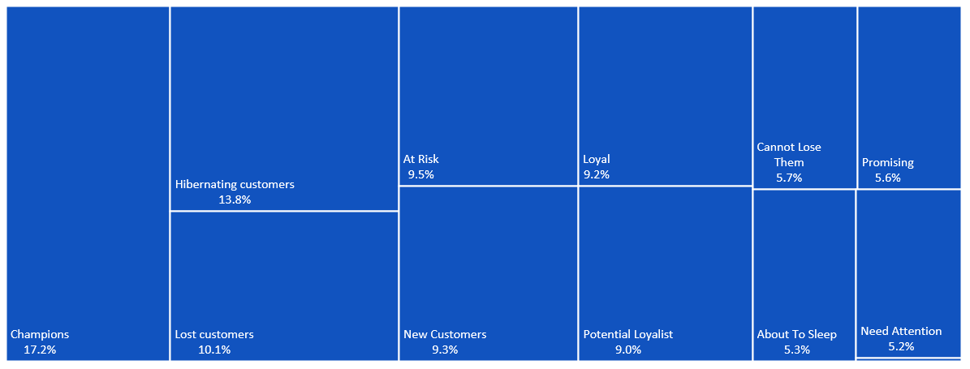
For further analysis (RFM segmentation)
User segments attribution

Slide 19
Thank you!
Contact me at myhao14159@gmail.com for more discussions

